Slide 1
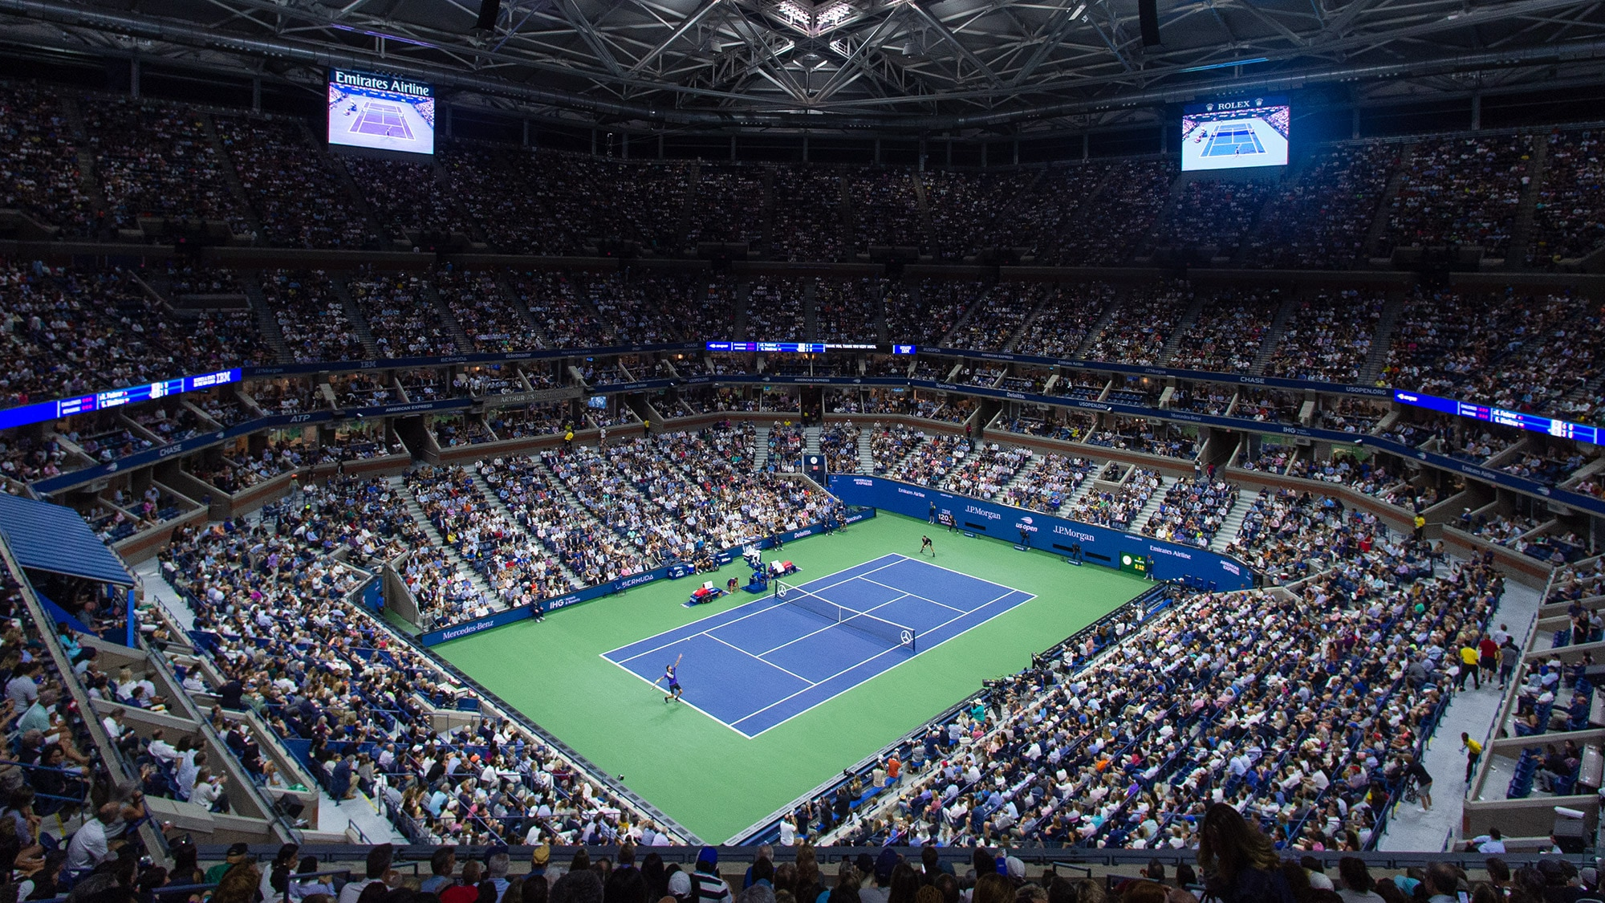
Tennisense
Ofek Glick, Matan Solomon, Yehonatan Peisakhovsky

Slide 2
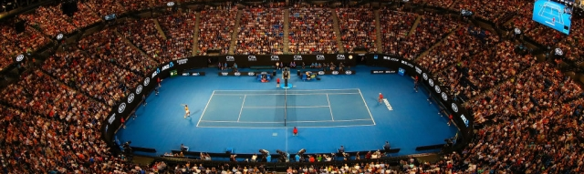
About us
At TenniSense, we believe that all tennis players should strive to be the best players they can be. Our wish is that every tennis player will have the tools he or she needs to improve at any time.

Slide 3
problem
lack of feedback
High demand
Real-time statistics help pros and amateurs alike improve specific aspects of their game
In the US alone, ~20 million people hit the courts every year
Lack of a coach
Access to professional coaching is a significant factor for improvement.
Lack of price options
All options on the market are overpriced

Slide 4
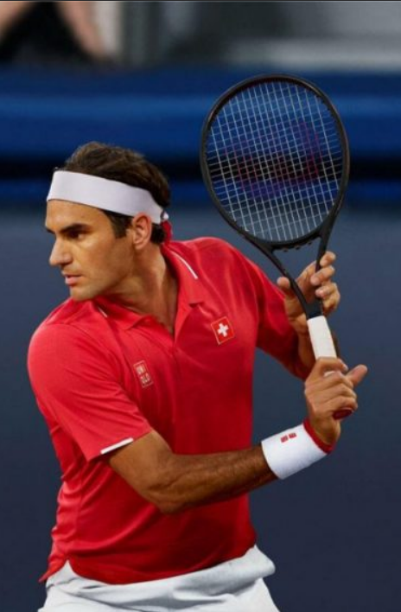
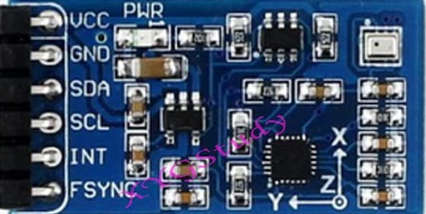
solution
Smart sensor
Target audience
An IMU attached to the throat of the racket.
Amateur and professional tennis players and coaches.
ANDROID APP
Easy to use
Accompanying app to interface with statistics regarding a player's abilities.
Once attached to racket, simply turn on and off to use.

Slide 5
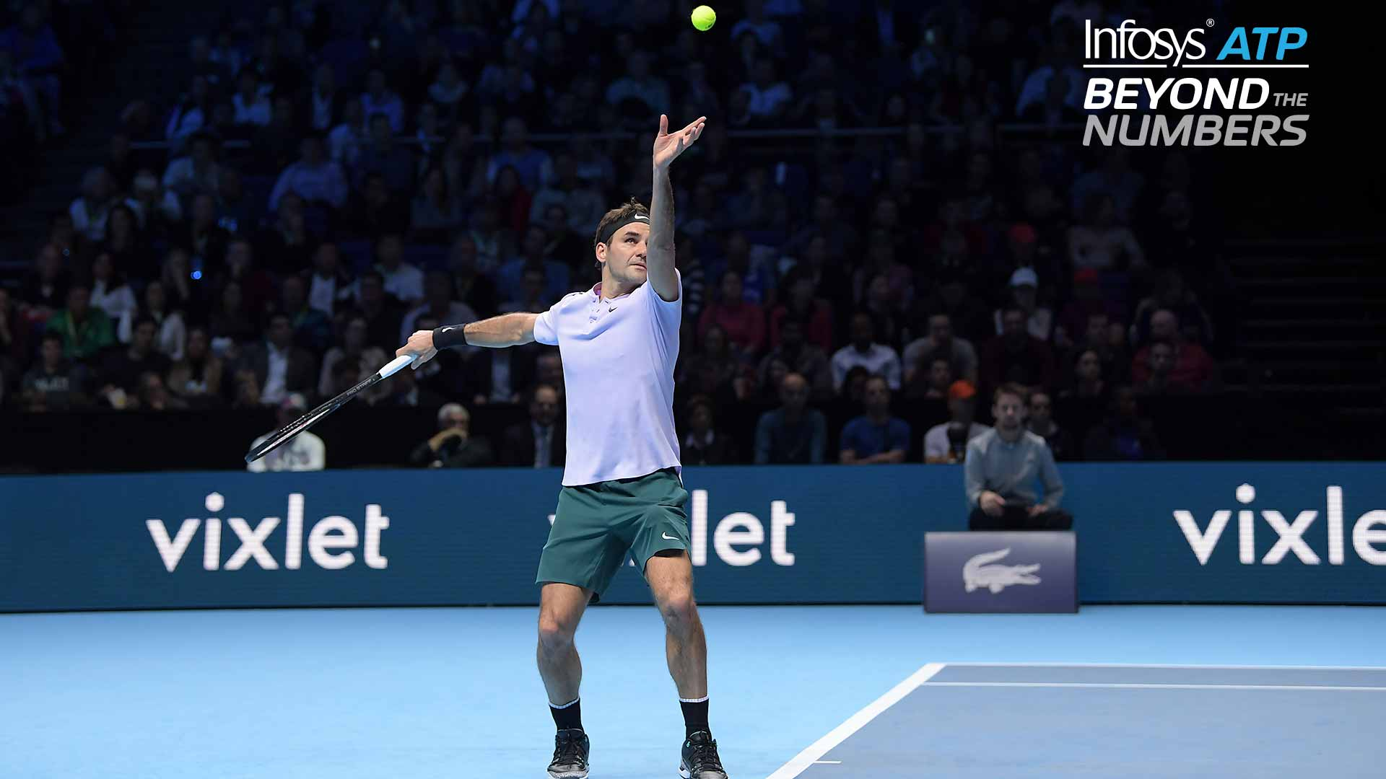
APP Overview

Slide 6

DEMONSTRATION

Slide 7




APP overview
Shot count
Shot type
Shot speed
calories
How many shots were played during the session.
Classify the shot as either Forehand/Backhand
The approximated maximum speed & acceleration of the racket during the session
Approx. How many calories were burnt during the session.

Slide 8
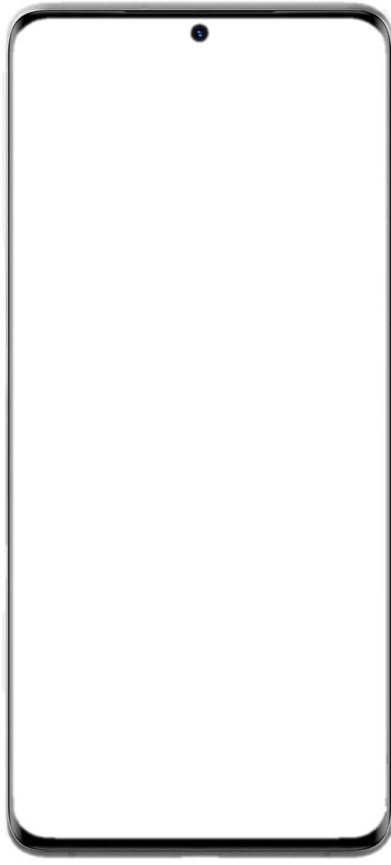
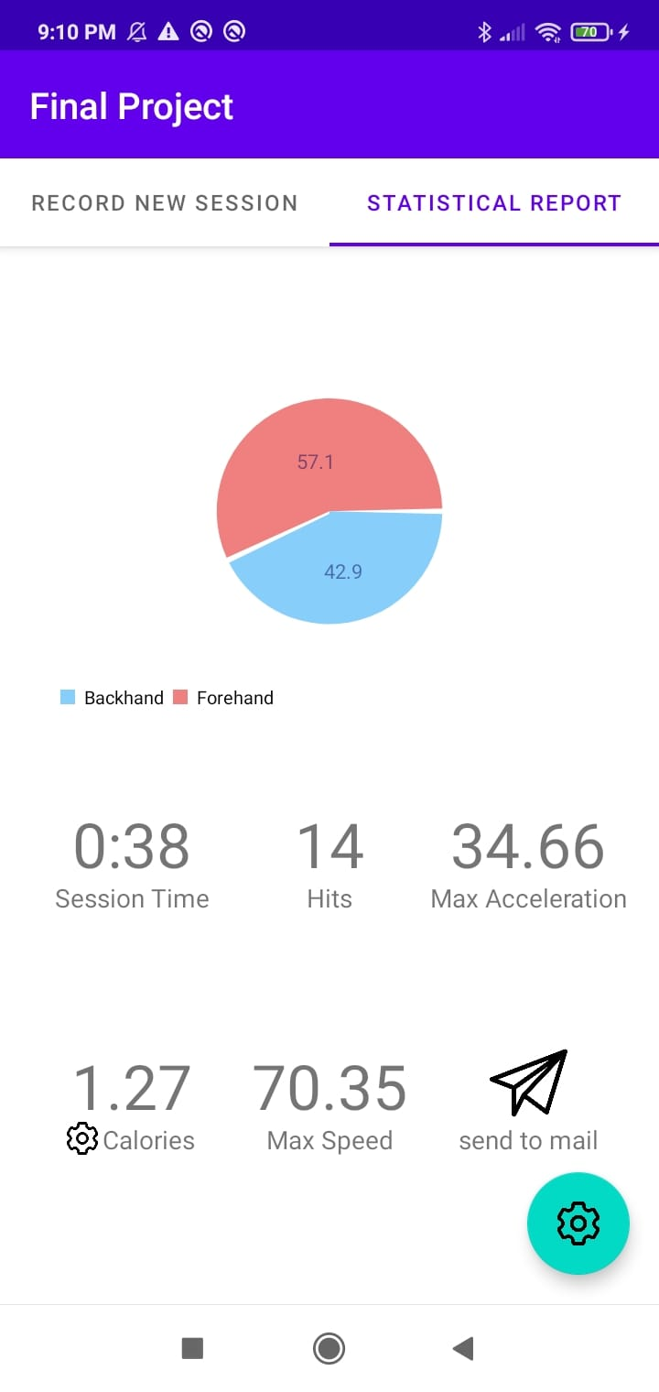
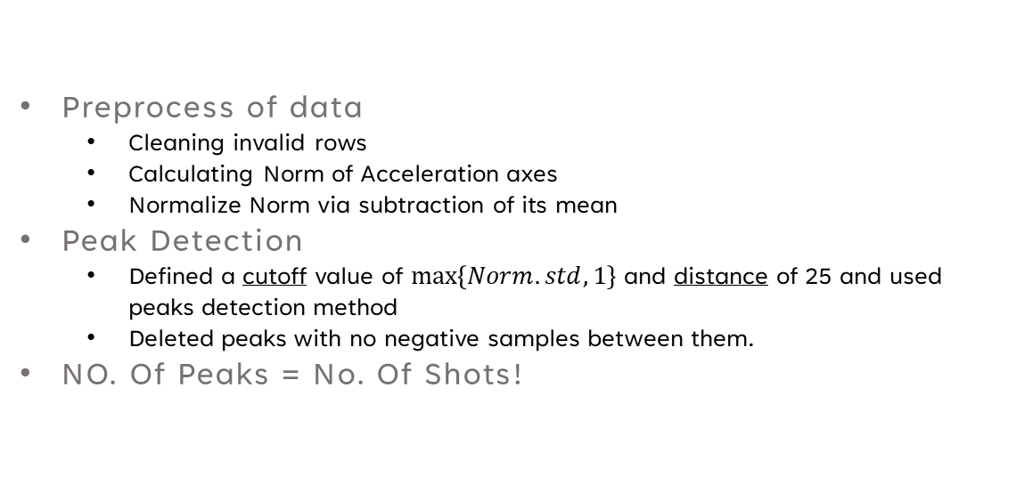
Analysis workflow
Shot Count
Peak Detection
Preprocess of data
Cleaning invalid rows
Calculating Norm of Acceleration axes
Normalize Norm via subtraction of its mean
Peak Detection
Defined a cutoff value of $max\left\{Norm.std,1\right\}$ and distance of 25 and used peaks detection method
Deleted peaks with no negative samples between them.
NO. Of Peaks = No. Of Shots!

Slide 9
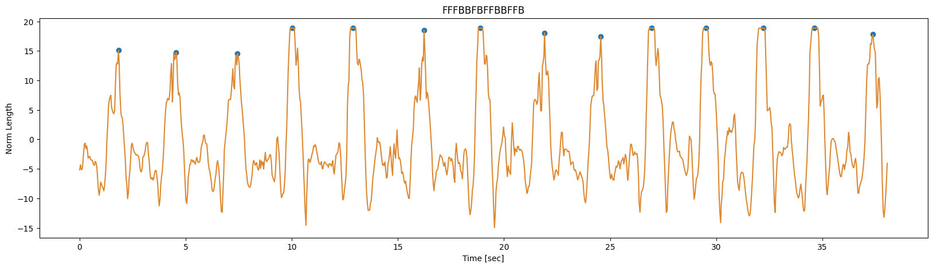
Analysis workflow
Shot Count
Peak Detection

Slide 10
Analysis workflow
Shot Type
Shot Classification
Shot Segmentation
“Cut” data into shot segments.
Feature Extraction
Extract defining features for each class of shots
Take 10 most statistically significant features.
Training process
Feed 10 sessions with an average of 10 hits per session – 100 hits in total.
Logistic Regression model with L1 regularization.
Prediction of new session!
10

Slide 11
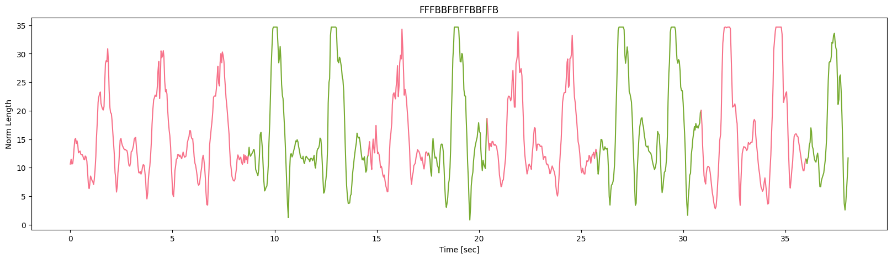
Analysis workflow
Shot Classification
Logistic Regression

Slide 12
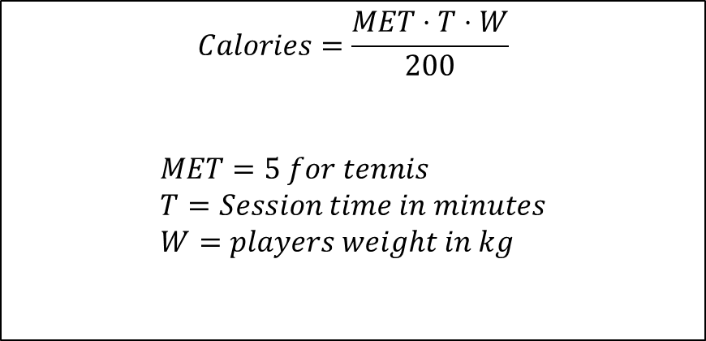
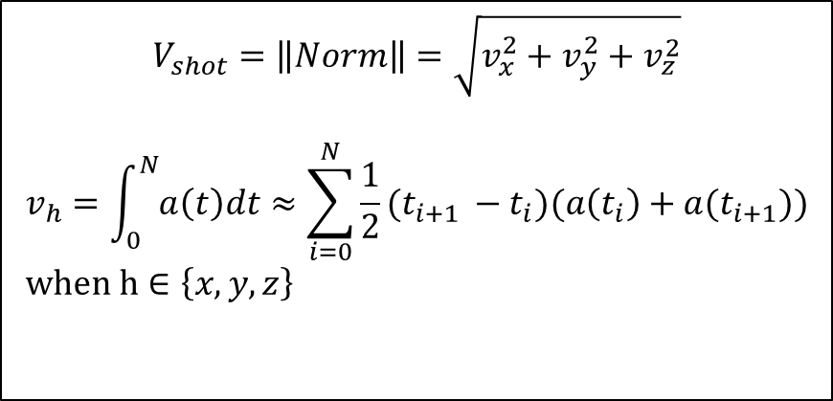
Analysis workflow
Calculation of shot speed and calories
Shot Speed
Calories
$$V_{shot}=\left\|Norm\right\|=\sqrt{v_{x}^{2}+v_{y}^{2}+v_{z}^{2}}$$
$$v_{h}=\int_{0}^{N}{a\left(t\right)dt}≈\sum_{i=0}^{N}{{\frac{1}{2}(t}_{i+1 }−t_{i})(a\left(t_{i}\right)+a(t_{i+1}))} \\ when h∈\left\{x,y,z\right\}$$
$$Calories=\frac{MET⋅T⋅W}{200}$$ $$MET=5 for tennis \\ T=Session time in minutes \\ W=players weight in kg$$

Slide 13
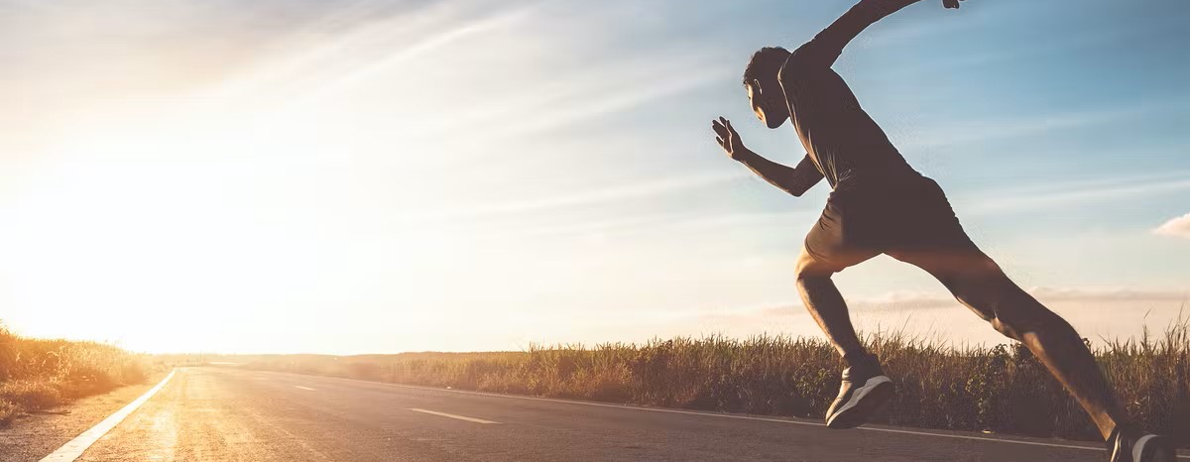
PART II - Workout
Activity Classification
Step estimator
Preprocess of the data
Anomaly Detection and Deletion
Feature extraction
Prediction using a trained Soft SVM
Preprocess and normalization of the Data
Anomaly Detection and Deletion
Smoothing the Norm variable
Finding peaks using peak detection method
Filter peaks who do not have “dips” between them

Slide 14
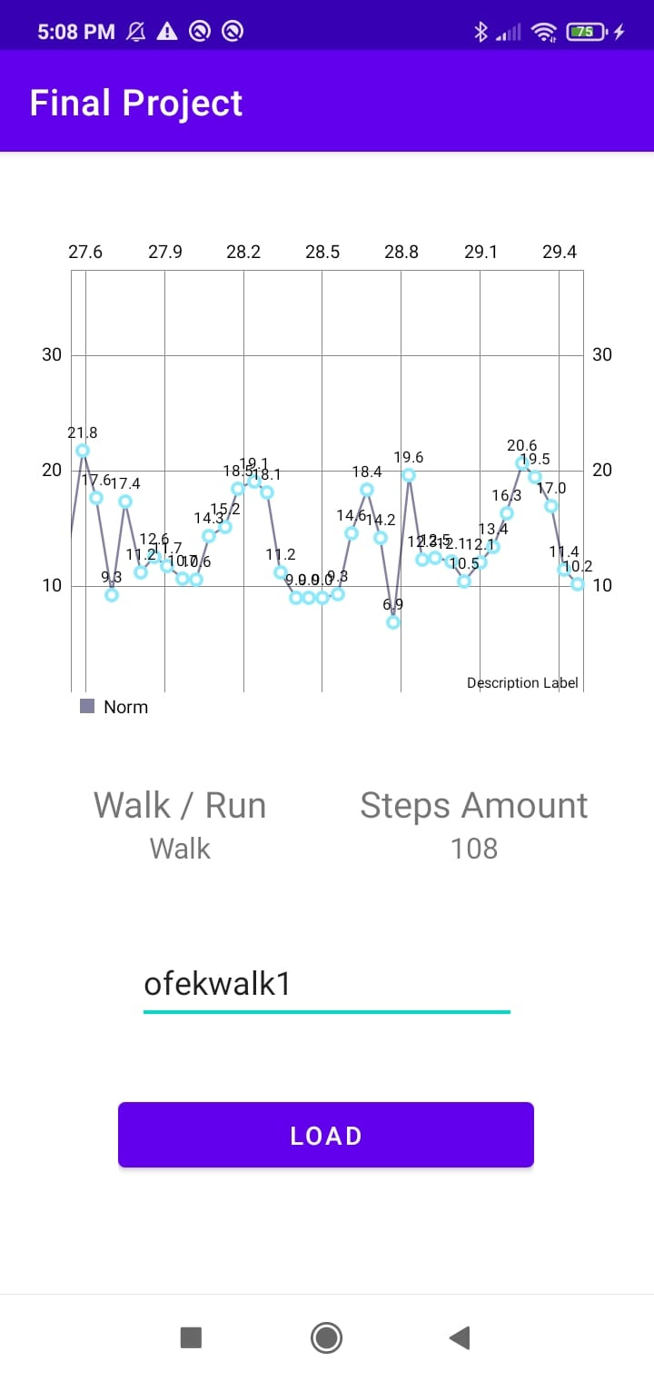
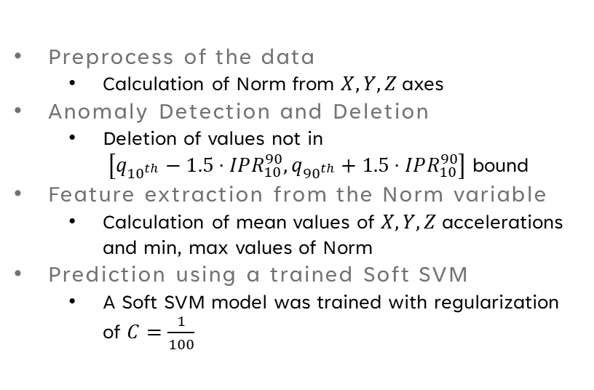
PART II - WORKFLOW
No. Steps estimation
Activity Classification Algorithm
Preprocess of the data
Calculation of Norm from $X,Y,Z$ axes
Anomaly Detection and Deletion
Deletion of values not in $\left[q_{{10}^{th}}−1.5⋅IPR_{10}^{90},q_{{90}^{th}}+1.5⋅IPR_{10}^{90}\right]$ bound
Feature extraction from the Norm variable
Calculation of mean values of $X,Y,Z$ accelerations and min, max values of Norm
Prediction using a trained Soft SVM
A Soft SVM model was trained with regularization of $C=\frac{1}{100}$

Slide 15
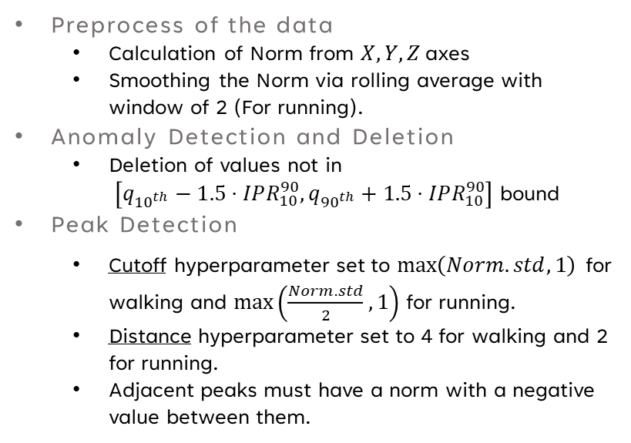
PART II - WORKFLOW
Step estimator
Step Estimator Algorithm
Preprocess of the data
Calculation of Norm from $X,Y,Z$ axes
Smoothing the Norm via rolling average with window of 2 (For running).
Anomaly Detection and Deletion
Deletion of values not in $\left[q_{{10}^{th}}−1.5⋅IPR_{10}^{90},q_{{90}^{th}}+1.5⋅IPR_{10}^{90}\right]$ bound
Peak Detection
Cutoff hyperparameter set to $\max\left(Norm.std,1\right)$ for walking and $\max\left(\frac{Norm.std}{2},1\right)$ for running.
Distance hyperparameter set to 4 for walking and 2 for running.
Adjacent peaks must have a norm with a negative value between them.
15

Slide 16
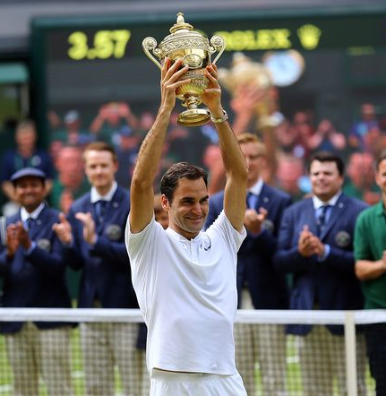
Thank you

